Slide 1
BASIC COMP. ARCHITECTURE Bachelor of Computer Science (Hons) (Network Technology and Cybersecurity) MODULE CODE: BCA114

Slide 2
CLO 7

Slide 3
What is Parallel Computing?
Traditionally, software has been written for serial computation:
To be run on a single computer having a single Central Processing Unit (CPU);
A problem is broken into a discrete series of instructions.
Instructions are executed one after another.
Only one instruction may execute at any moment in time.

Slide 4
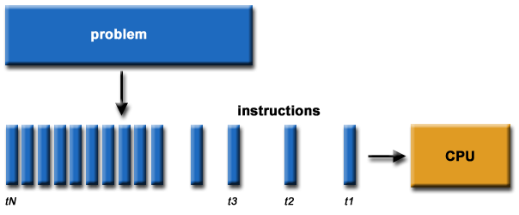

Slide 5
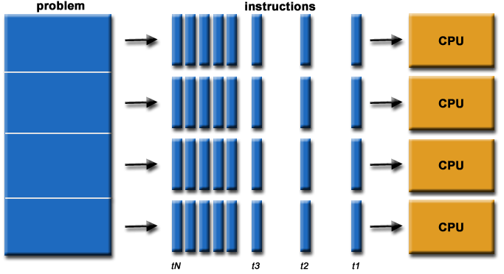
What is Parallel Computing?
In the simplest sense, parallel computing is the simultaneous use of multiple compute resources to solve a computational problem.
To be run using multiple CPUs
A problem is broken into discrete parts that can be solved concurrently
Each part is further broken down to a series of instructions
Instructions from each part execute simultaneously on different CPUs

Slide 6
Parallel Computing: Resources
The compute resources can include:
A single computer with multiple processors;
A single computer with (multiple) processor(s) and some specialized computer resources [GPU(Graphics processing Unit), FPGA(Field Programmable Gate Array) …]
An arbitrary number of computers connected by a network;
A combination of both.

Slide 7
Parallel Computing: The computational problem
The computational problem usually demonstrates characteristics such as the ability to be:
Broken apart into discrete pieces of work that can be solved simultaneously;
Execute multiple program instructions at any moment in time;
Solved in less time with multiple compute resources than with a single compute resource.

Slide 8
Parallel Computing: what for?
Parallel computing is an evolution of serial computing that attempts to emulate what has always been the state of affairs in the natural world: many complex, interrelated events happening at the same time, yet within a sequence.
Some examples:
Planetary and galactic orbits
Weather and ocean patterns
Tectonic plate drift
Rush hour traffic in Paris
Automobile assembly line
Daily operations within a business
Building a shopping mall
Ordering a hamburger at the drive through.

Slide 9
Parallel Computing: what for?
Traditionally, parallel computing has been considered to be "the high end of computing" and has been motivated by numerical simulations of complex systems and "Grand Challenge Problems" such as:
weather and climate
chemical and nuclear reactions
biological, human genome
geological, seismic activity
mechanical devices - from prosthetics to spacecraft
electronic circuits
manufacturing processes

Slide 10
Parallel Computing: what for?
Today, commercial applications are providing an equal or greater driving force in the development of faster computers. These applications require the processing of large amounts of data in sophisticated ways. Example applications include:
parallel databases, data mining
oil exploration
web search engines, web based business services
computer-aided diagnosis in medicine
management of national and multi-national corporations
advanced graphics and virtual reality, particularly in the entertainment industry
networked video and multi-media technologies
collaborative work environments
Ultimately, parallel computing is an attempt to maximize the infinite but seemingly scarce commodity called time.

Slide 11
Why Parallel Computing?
This is a legitime question! Parallel computing is complex on any aspect!
The primary reasons for using parallel computing:
Save time - wall clock time
Solve larger problems
Provide concurrency (do multiple things at the same time)

Slide 12
Why Parallel Computing?
Other reasons might include:
Taking advantage of non-local resources - using available compute resources on a wide area network, or even the Internet when local compute resources are scarce.
Cost savings - using multiple "cheap" computing resources instead of paying for time on a supercomputer.
Overcoming memory constraints - single computers have very finite memory resources. For large problems, using the memories of multiple computers may overcome this obstacle.

Slide 13
Limitations of Serial Computing
Limits to serial computing - both physical and practical reasons pose significant constraints to simply building ever faster serial computers.
Transmission speeds - the speed of a serial computer is directly dependent upon how fast data can move through hardware. Absolute limits are the speed of light (30 cm/nanosecond) and the transmission limit of copper wire (9 cm/nanosecond). Increasing speeds necessitate increasing proximity of processing elements.
Limits to miniaturization - processor technology is allowing an increasing number of transistors to be placed on a chip. However, even with molecular or atomic-level components, a limit will be reached on how small components can be.
Economic limitations - it is increasingly expensive to make a single processor faster. Using a larger number of moderately fast commodity processors to achieve the same (or better) performance is less expensive.

Slide 14
The future
during the past 10 years, the trends indicated by ever faster networks, distributed systems, and multi-processor computer architectures (even at the desktop level) clearly show that parallelism is the future of computing.
It will be multi-forms, mixing general purpose solutions (your PC…) and very specialized solutions as IBM Cells, ClearSpeed, GPGPU from NVidia …

Slide 15
Who and What?
Top500.org provides statistics on parallel computing users - the charts below are just a sample. Some things to note:
Sectors may overlap - for example, research may be classified research. Respondents have to choose between the two.
"Not Specified" is by far the largest application - probably means multiple applications.

Slide 16
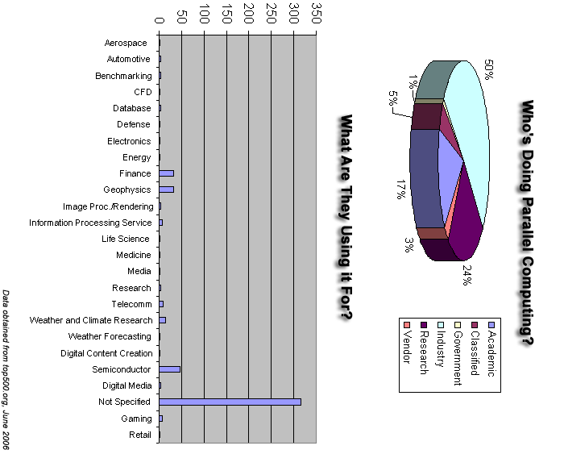
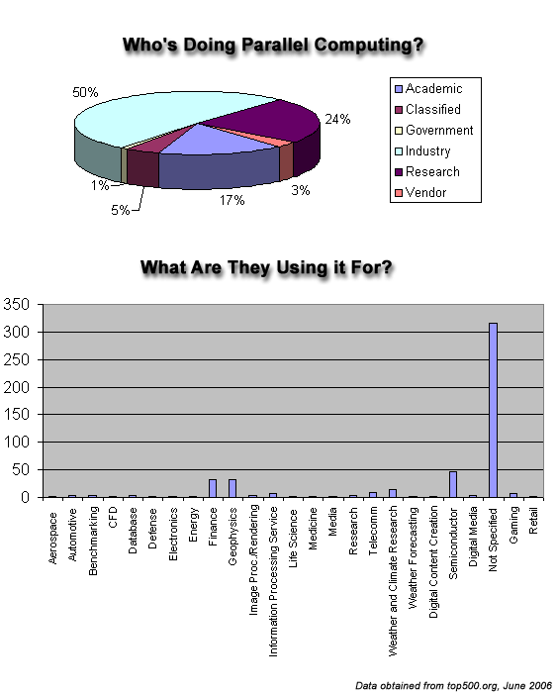
Who and What? (2)

Slide 17
Memory architectures
Shared Memory
Distributed Memory
Hybrid Distributed-Shared Memory

Slide 18
Shared Memory
Shared memory parallel computers vary widely, but generally have in common the ability for all processors to access all memory as global address space.
Multiple processors can operate independently but share the same memory resources.
Changes in a memory location effected by one processor are visible to all other processors.
Shared memory machines can be divided into two main classes based upon memory access times: UMA and NUMA.

Slide 19
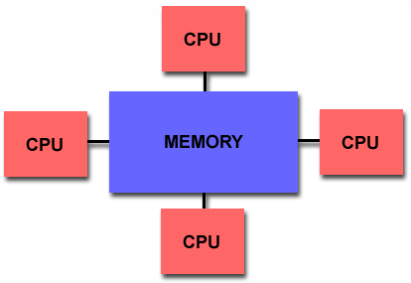

Slide 20
Shared Memory: Pro and Con
Advantages
Global address space provides a user-friendly programming perspective to memory
Data sharing between tasks is both fast and uniform due to the proximity of memory to CPUs
Disadvantages:
Primary disadvantage is the lack of scalability between memory and CPUs. Adding more CPUs can geometrically increases traffic on the shared memory-CPU path, and for cache coherent systems, geometrically increase traffic associated with cache/memory management.
Programmer responsibility for synchronization constructs that insure "correct" access of global memory.
Expense: it becomes increasingly difficult and expensive to design and produce shared memory machines with ever increasing numbers of processors.

Slide 21
Distributed Memory
Like shared memory systems, distributed memory systems vary widely but share a common characteristic. Distributed memory systems require a communication network to connect inter-processor memory.
Processors have their own local memory. Memory addresses in one processor do not map to another processor, so there is no concept of global address space across all processors.
Because each processor has its own local memory, it operates independently. Changes it makes to its local memory have no effect on the memory of other processors. Hence, the concept of cache coherency does not apply.
When a processor needs access to data in another processor, it is usually the task of the programmer to explicitly define how and when data is communicated. Synchronization between tasks is likewise the programmer's responsibility.
The network "fabric" used for data transfer varies widely, though it can can be as simple as Ethernet.

Slide 22
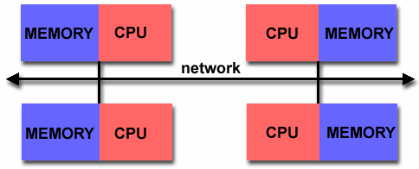

Slide 23
Distributed Memory: Pro and Con
Advantages
Memory is scalable with number of processors. Increase the number of processors and the size of memory increases proportionately.
Each processor can rapidly access its own memory without interference and without the overhead incurred with trying to maintain cache coherency.
Cost effectiveness: can use commodity, off-the-shelf processors and networking.
Disadvantages
The programmer is responsible for many of the details associated with data communication between processors.
It may be difficult to map existing data structures, based on global memory, to this memory organization.
Non-uniform memory access (NUMA) times

Slide 24
Hybrid Distributed-Shared Memory
The largest and fastest computers in the world today employ both shared and distributed memory architectures.
The shared memory component is usually a cache coherent SMP machine. Processors on a given SMP can address that machine's memory as global.
The distributed memory component is the networking of multiple SMPs. SMPs know only about their own memory - not the memory on another SMP. Therefore, network communications are required to move data from one SMP to another.
Current trends seem to indicate that this type of memory architecture will continue to prevail and increase at the high end of computing for the foreseeable future.
Advantages and Disadvantages: whatever is common to both shared and distributed memory architectures.

Slide 25
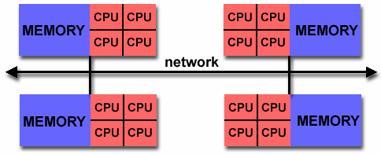

Slide 26
Overview –Interrelated topics
Multiprocessor Systems
Distributed Systems
Distributed File Systems

Slide 27
Distributed Systems
Nearly all systems today are distributed in some way, e.g.:
they use email
they access files over a network
they access printers over a network
they are backed up over a network
they share other physical or logical resources
they cooperate with other people on other machines
they receive video, audio, etc.

Slide 28
Distributed Systems – Why?
Distributed systems are now a requirement:
Economics – small computers are very cost effective
Resource sharing
sharing and printing files at remote sites
processing information in a distributed database
using remote specialized hardware devices
Many applications are by their nature distributed (bank teller machines, airline reservations, ticket purchasing)
Computation speedup – To solve the largest or most data intensive problems , we use many cooperating small machines (parallel programming)
Reliability

Slide 29
What is a Distributed System? And its types
There are several levels of distribution.
Earliest systems used simple explicit network programs:
FTP: file transfer program
Telnet (rlogin): remote login program
mail
remote job entry (or rsh): run jobs remotely
Each system was a completely autonomous independent system, connected to others on the network

Slide 30
Loosely Coupled Systems
Most distributed systems are “loosely-coupled
Each CPU runs an independent autonomous OS
Hosts communicate through message passing.
Computers/systems don’t really trust each other
Some resources are shared, but most are not
The system may look differently from different hosts
Typically, communication times are long
Relative to processing times

Slide 31
Closely-Coupled Systems
Distributed system becomes more “closely coupled” as it:
appears more uniform in nature
runs a “single” operating system (cooperating across all machines)
has a single security domain
shares all logical resources (e.g., files)
shares all physical resources (CPUs, memory, disks, printers, etc.)
In the limit, a closely coupled distributed system: –
Multicomputer
Multiple computers – CPU and memory and network interface (NIC)
High performance interconnect
Looks a lot like a single system
E.g., Beowulf clusters

Slide 32
Tightly Coupled Systems
Tightly coupled systems usually are multiprocessor systems
Have a single address space
Usually has a single bus or backplane to which all processors and memories are connected
Low communication latency
Shared memory for processor communication
Shared I/O device access
Example:
Multiprocessor Windows PC

Slide 33
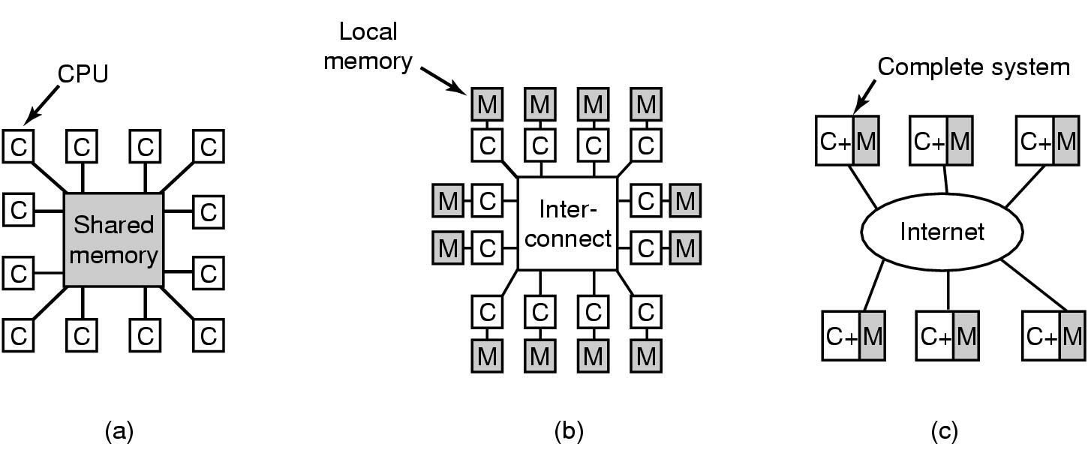
Distributed Systems – a Spectrum
Tightly coupled
Multiprocessor
Latency – nanoseconds
Closely coupled
Multicomputer
Latency – microseconds
Loosely coupled
Latency – milliseconds

Slide 34
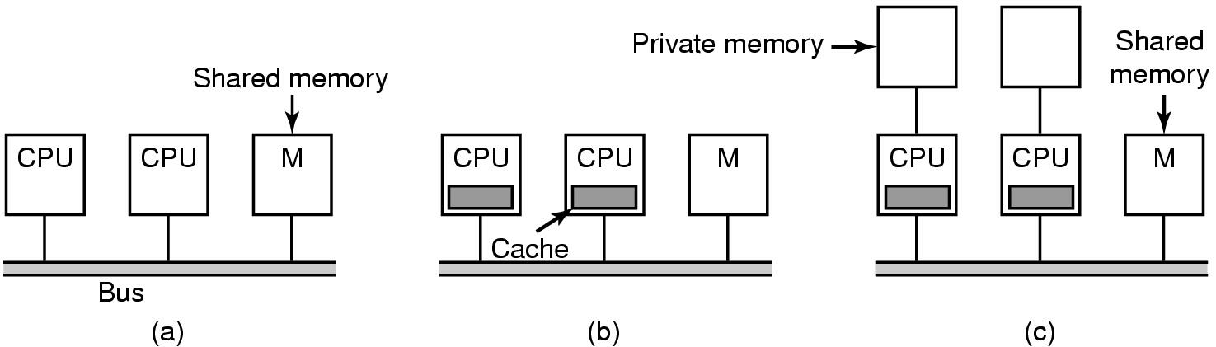
Multiprocessors (1) – Bus-based
Bus contention limits the number of CPUs
Lower bus contention
Caches need to be synced (big deal)
Compiler places data and text in private or shared memory

Slide 35
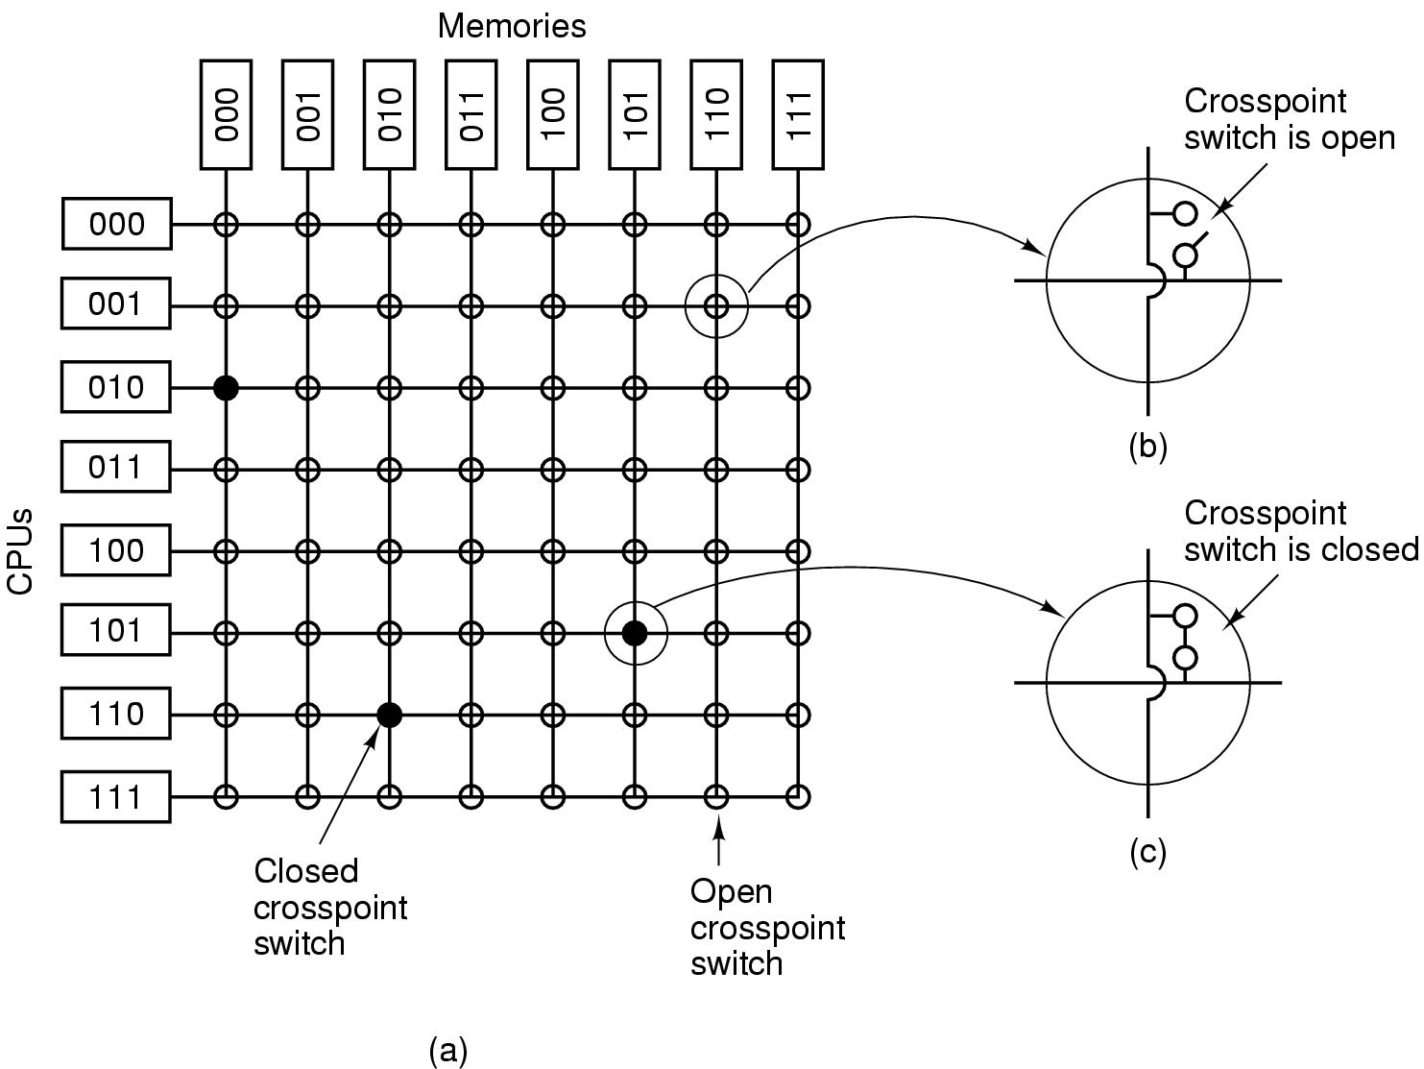
Multiprocessors (2) - Crossbar
Can support a large number of CPUs -
Non-blocking network
Cost/performance effective up to about 100 CPU – growing as n²

Slide 36
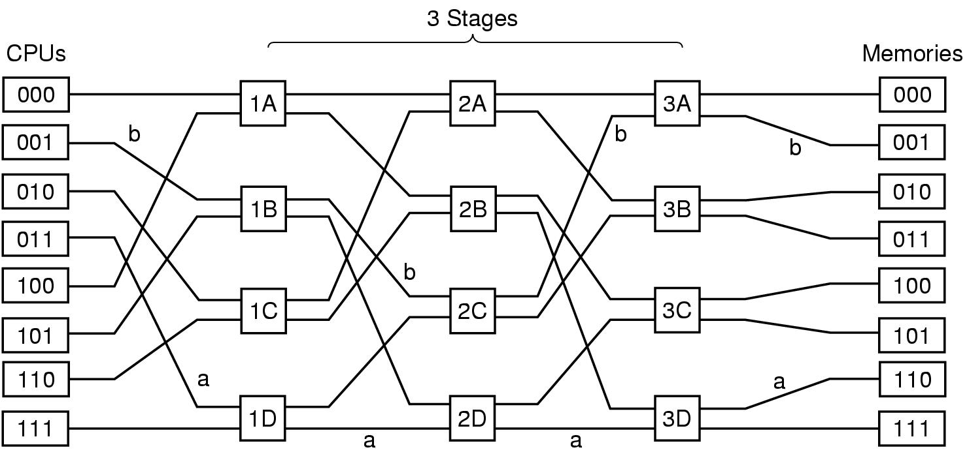
Multiprocessors(3) – Multistage Switching Networks
Omega Network – blocking
Lower cost, longer latency
For N CPUs and N memories – log₂ n stages of n/2 switches

Slide 37
Type of Multiprocessors – UMA vs. NUMA
UMA (Uniform Memory Access)
Shared Memory Multiprocessor
Familiar programming model
Number of CPUs are limited
Completely symmetrical
NUMA (Non-Uniform Memory Access)
Single address space visible to all CPUs
Access to remote memory via commands
LOAD & STORE
remote memory access slower than to local

Slide 38
Caching vs. Non-caching
No caching
Remote access time not hidden
Slows down a fast processor
May impact programming model
Caching
Hide remote memory access times
Complex cache management hardware
Some data must be marked as non-cachable
Visible to programming model

Slide 39
Multiprocessor OS – Private OS
Each processor has a copy of the OS
Looks and generally acts like N independent computers
May share OS code
OS Data is separate
I/O devices and some memory shared
Synchronization issues
While simple, benefits are limited

Slide 40
Multiprocessor OS – Master-Slave
One CPU (master) runs the OS and applies most policies
Other CPUs
run applications
Minimal OS to acquire and terminate processes
Relatively simple OS
Master processor can become a bottleneck for a large number of slave processors

Slide 41
Multiprocessor OS – Symmetric Multi-Processor (SMP)
Any processor can execute the OS and applications
Synchronization within the OS is the issue
Lock the whole OS – poor utilization – long queues waiting to use OS
OS critical regions – much preferred
Identify independent OS critical regions that be executed independently – protect with mutex
Identify independent critical OS tables – protect access with MUTEX
Design OS code to avoid deadlocks
The art of the OS designer
Maintenance requires great care

Slide 42
Multiprocessor OS – SMP (continued)
Multiprocessor Synchronization
Need special instructions – test-and-set
Spinlocks are common
Can context switch if time in critical region is greater than context switch time
OS designer must understand the performance of OS critical regions
Context switch time could be onerous
Data cached on one processor needs to be re-cached on another

Slide 43
Multiprocessor Scheduling
When processes are independent (e.g., timesharing)
Allocate CPU to highest priority process
Tweaks
For a process with a spinlock, let it run until it releases the lock
To reduce TLB(Translation lookaside buffer) and memory cache flushes, try to run a process on the same CPU each time it runs
For groups of related processes
Attempt to simultaneously allocate CPUs to all related processes (space sharing)
Run all threads to termination or block
Gang schedule – apply a scheduling policy to related processes together

Slide 44
Multicomputer Systems
Tightly coupled
Multiprocessor
Latency – nanoseconds
Closely coupled
Multicomputer
Latency – microseconds
Loosely coupled
Latency – milliseconds

Slide 45
Multicomputers
Multiprocessor size is limited
Multi computers – closely coupled processors that do not physically share memory
Cluster computers
Networks or clusters of computers (NOWs or COWs)
Can grow to a very large number of processors
Consist of
Processing nodes – CPU, memory and network interface (NIC)
I/O nodes – device controller and NIC
Interconnection network
Many topologies – e.g. grid, hypercube, torus
Can be packet switched or circuit switched

Slide 46
Inter-Process Communication (IPC) among computers
Processes on separate processors communicate by messages
Message moved to NIC send buffer
Message moved across the network
Message copied into NIC receive buffer
destination host addr.
destination host addr.
source host addr.
header
application ID
msg length
msg data
checksum

Slide 47
Interprocessor Communication
Copying of messages is a major barrier to achieving high performance
Network latency may involve copying message (hardware issue)
Must copy message to NIC on send and from NIC on receive
Might have additional copies between user processes and kernel (e.g., for error recovery)
Could map NIC into user space – creates some additional usage and synchronization problems

Slide 48
Multicomputer Scheduling
Typically each node has its own scheduler
With a coordinator on one node, gang scheduling is possible for some applications
Most scheduling is done when processes are created
i.e., allocation to a processor for life of process
Load Balancing – efficiently use the system’s resources
Many models – dependent on what is important
Examples
Sender-initiated - when overloaded send process to another processor
Receiver-initiated – when underloaded ask another processor for a job

